Slide 1
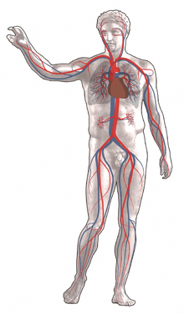
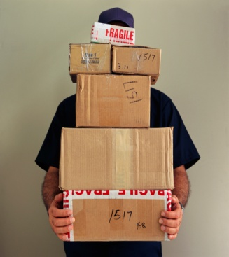
The Circulatory System
The Circulatory System is the body’s delivery and transport system.
It is more commonly referred to in science as the Cardiovascular system.
  “Cardio” meaning “heart”.
  “Vascular” meaning “related to blood vessels.”
Cardiovascular literally means heart and the blood vessels.

Slide 2

Components of the Cardiovascular System
  Heart
  Blood
  Blood Vessels
Functions of the Cardiovascular System
  Delivering needed materials
    Examples: Oxygen, Glucose, Vitamins, Minerals, etc.
  Removal of wastes
    Example: Carbon dioxide
  Fighting disease

Slide 3
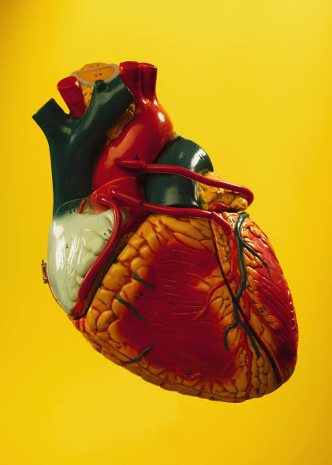
The Heart
  Hollow muscular organ that is responsible for pumping blood throughout the body.
  Made of cardiac muscle.
  2 Separate sides
    Septum is the tissue wall that separates the right side of the heart from the left side of the heart.
    Each side has 2 separate chambers
      Atrium: Upper chambers of the heart
        One on each side (left & right)
        Receives blood into the heart
      Ventricle: lower chambers of the heart
        One on each side (left & right)
        Pumps blood out of the heart

Slide 4
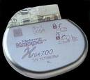
    Valves are flaps of tissue located inside the heart that separates the atrium, ventricle & directs blood flow.
      Tricuspid: between right atrium & right ventricle
      Pulmonary: between right ventricle & pulmonary artery
      Mitral (Bicuspid): between left atrium & left ventricle
      Aortic: between left ventricle & aorta
  Operates in 2 phases
    Phase 1: heart muscle relaxes & the heart fills with blood
    Phase 2: heart muscle contracts & the blood is pumped forward
  Heart beat regulated by a pacemaker
    Natural pacemaker is a group of cells located in the right atrium that monitors the body’s need for oxygen & adjust the heart rate to meet the need.
    Artificial pacemaker is an electrical device implanted in a patient that regulates the heartbeat.
      Can be affected or disrupted by microwaves.

Slide 5
The 2 Loops of the Heart
  Loop 1: Right Pump
    Blood travels from the heart to the lungs & then back to the heart.
      Oxygen poor/Carbon dioxide rich blood flows into right atrium from the body.
      This blood is then pumped through the tricuspid valve into the right ventricle.
      The ventricles pump the blood through the pulmonary valve into the pulmonary artery that leads to the lungs.
        Pulmonary: means lungs
      There the lungs exchange fresh oxygen for carbon dioxide.
      The now oxygen rich blood flows from the lungs into the left side of the heart or the 2nd loop.

Slide 6
  Loop 2: Left Pump
    Blood travels from the lungs to the heart & then to the body.
      Oxygen rich blood flows into left atrium from the lungs.
      This blood is then pumped through the mitral/bicuspid valve into the left ventricle.
      The ventricles pump the blood through the aortic valve into the aorta that leads to the body.
      The contraction of the left ventricle is greater creating more force as this push is needed to pump the body throughout the entire body.
      Throughout the body blood drops off oxygen to various cells & picks up carbon dioxide.
      This Oxygen poor/Carbon dioxide rich blood flows back to the right side of the heart to begin the 2 loops process all over again.

Slide 7
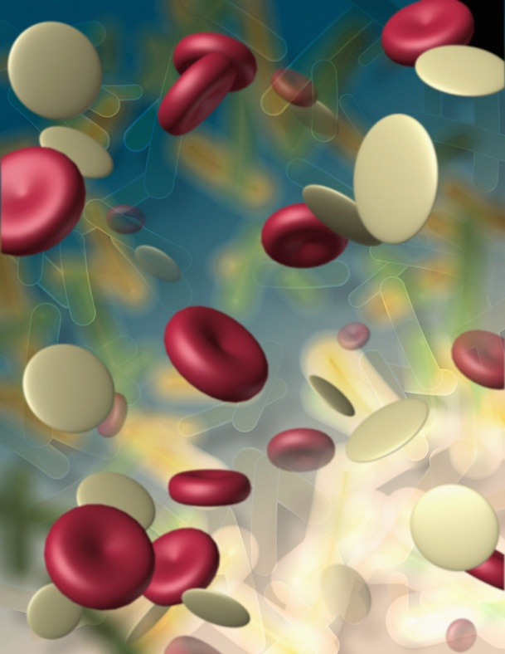
Blood is a specialized bodily fluid in animals that delivers necessary substances such as nutrients and oxygen to the cells and transports waste products away from those same cells.
Medical terms related to blood often begin with hemo- or hemato- from the Greek word for "blood".
Blood is considered a specialized form of connective tissue, given its origin in the bones.
Blood is composed of 4 parts
  Plasma
  Red Blood Cells
  White Blood Cells
  Platelets
45% is cells; 55% is plasma

Slide 8
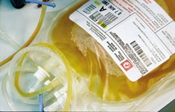
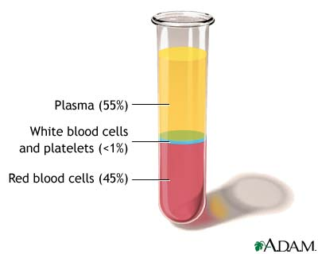
Plasma
  Liquid portion of blood
  90% water; 10% dissolved materials such as glucose, fats, vitamins, & minerals.
  Also carries waste materials & any messenger chemicals.
  Yellowish tint due to 3 proteins found in plasma
    Albumins: regulate water in blood
    Globulins: helps fight disease
    Fibrinogen: helps form blood clots

Slide 9
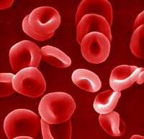
Red blood cells (Erythrocytes)
  Carry and deliver oxygen.
  Circular shaped with an indented center.
  Produced from red bone marrow.
  Contain no nucleus therefore cannot repair or reproduce.
  Approximate live span is 120 days or 4 months.
  Primarily composed of hemoglobin
    Hemoglobin is an iron containing protein that bonds to oxygen; when bonded or joined with oxygen, it produces a bright red color.
  Diseases of red blood cells
    Anemia is reduced number of red blood cells within the body due to different factors.

Slide 10
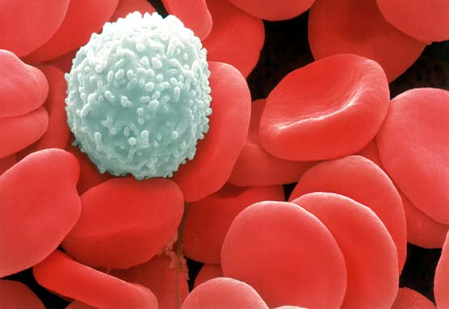
White blood cells (Leukocytes)
  Also produced in the bone marrow.
  Disease fighters of the blood stream.
  5 primary types of white blood cells; 2 most common bacterial, viral, cancer fighters.
    Granulocytes
    Lymphocytes
  1 white blood cell for every 500 to 1,000 red blood cells.
  Larger in size than their red blood cell counterparts.
  White blood cells contain a nucleus & therefore can repair themselves.
  Life span can be months to years.
  Diseases of White blood cells
    Leukemia: cancer of the white blood cells
    HIV: virus that attacks specific lymphocytes

Slide 11
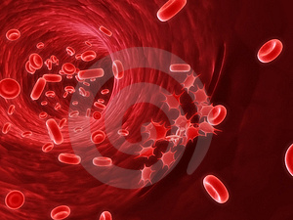
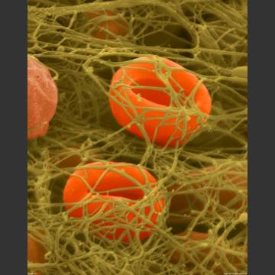
Platelets (Thrombocytes)
  Cell fragments primarily responsible for blood clotting.
  Fibrin is a protein produced by platelets that produces thin fibers that criss-crossing each to form a net to catch blood cells.
  Blood clot (scab) forms as more & more blood is cot in the net and dry as it is exposed to the air effectively forming a covering to allow the skin
  & blood vessels underneath to repair themselves.
  Average life span of a platelet, 9 days.
  Disease of Platelets
    Thrombocytopenia: low number of platelets

Slide 12
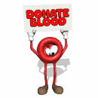
Blood typing
  4 major blood types
    A; contains the A marker protein
    B; contains the B marker protein
    AB; contains both marker proteins
    O; contain no marker proteins
  Marker molecules are proteins located on red blood cells.
  Clumping proteins are made for the opposite marker molecules than those found on a person’s own red blood cells.
    Example: Type A; anti B clumping proteins.
  Rh factor another protein found on red blood cells; 85% are positive for it (+) and 15% are negative for it (-)
    Negatives make anti (+) clumping proteins but positives don’t make anti (-) clumping proteins.

Slide 13
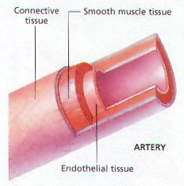
There are 3 main types of blood vessels; arteries, veins, and capillaries.
Arteries
  Carry oxygen rich blood throughout the body.
  3 thick layers
    Outside layer: Connective tissue
    Middle layer: Thick smooth muscle tissue
    Inner layer: smooth Epithelial tissue
  Structure of arteries offers both strength (muscle tissue), flexibility (connective tissue) and freedom of blood flow (epithelial tissue).
  Aorta is the largest artery in the body.
    All arteries branch off from the aorta like the branches of a tree.
    Coronary arteries are arteries that supply the cells of the heart with oxygen.

Slide 14
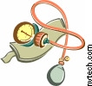
  A person’s pulse is created by the expansion & relaxation of the artery walls.
  Arteries can expand or contract to restrict blood flow to an area.
    Example: Exercising blood flow increases to muscles and lung cells.
    Example: During digestion blood flow to the digestive system increases
      This is one reason why you should not do strenuous exercise right after eating.
  Blood pressure is the force exerted on the walls of arteries as blood is pumped through the ventricles of the heart.
    Blood pressure decreases the further it travels from the heart.
      Inadequate blood pressure can mean not enough oxygen and nutrients are being delivered to vital organs such as the brain, heart, etc., preventing these organs from functioning properly and may lead to temporary or permanent damage.
    Measured using a sphygmomanometer or blood pressure cup.

Slide 15
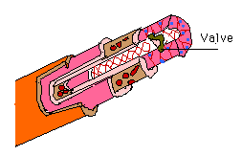
Veins
  Carry oxygen poor/carbon dioxide rich blood throughout the body.
  3 layers; layers not as thick as in arteries
    Outer layer: Connective tissue
    Middle layer: Smooth muscle
    Inner layer: Epithelial tissue
  Contraction of skeletal muscles help to push blood through veins back to the heart.
Capillaries
  Connection point between arteries & veins.
  Exchange point between body’s cells and blood
    Diffusion: process where substances move from an area of high concentration (a lot in a small area) to low concentration (same amount but a bigger area).
  Single layer of smooth epithelial tissue.

